Slide 1
A Comparative Study on Fake Job Post Prediction Using Different Data mining Techniques

Slide 2
ABSTRACT
In recent years, due to advancement in modern technology and social communication, advertising new job posts has become very common issue in the present world. So, fake job posting prediction task is going to be a great concern for all. Like many other classification tasks, fake job posing prediction leaves a lot of challenges to face. This paper proposed to use Random Forest Classifier predict a job post if it is real or fraudulent.

Slide 3
EXISTING SYSTEM
Vidros et al. identified job scammers as fake online job advertiser. They found statistics about many real and renowned companies and enterprises who produced fake job advertisements or vacancy posts with ill-motive. They experimented on EMSCAD dataset using several classification algorithms like naive bayes classifier, random forest classifier, Zero R, One R etc. Random Forest Classifier showed the best performance on the dataset with 89.5% classification accuracy. They found logistic regression performing very poor on the dataset.

Slide 4
Alghamdi et al. proposed a model to detect fraud exposure in an online recruitment system. They experimented on EMSCAD dataset using machine learning algorithm. They worked on this dataset in three steps- data pre-processing, feature selection and fraud detection using classifier. In the preprocessing step, they removed noise and html tags from the data so that the general text pattern remained preserved. They applied feature selection technique to reduce the number of attributes effectively and efficiently.

Slide 5
DISADVANTAGES OF EXISTING SYSTEM
Online job advertisements which are fake and mostly willing to steal personal and professional information of job seekers instead of giving right jobs to them is known as job scam. Sometimes fraudulent people try to gather money illegally from job seekers. A recent survey by ActionFraud from UK has shown that more than 67% people are at great risk who look for jobs through online advertisements but unaware of fake job posts or job scam.

Slide 6
Existing system results have less accuracy.
More time taking process.
Complexity in implementing the system.
Existing system considers more features, which leads for increase in time and cost.

Slide 7
PROPOSED SYSTEM
The target of this study is to detect whether a job post is fraudulent or not. Identifying and eliminating these fake job advertisements will help the jobseekers to concentrate on legitimate job posts only. In this context, a dataset from Kaggle is employed that provides information regarding a job that may or may not be suspicious.

Slide 8
This dataset contains 17,880 number of job posts. This dataset is used in the proposed methods for testing the overall performance of the approach. For better understanding of the target as a baseline, a multistep procedure is followed for obtaining a balanced dataset. Before fitting this data to any classifier, some pre-processing techniques are applied to this dataset.

Slide 9
Random Forest Classifier is applied for classifying job post as fake. The performance measure metrics such as Accuracy, Recall, Precision, and Confusion matrix are used for evaluating the prediction for proposed classifier.

Slide 10
ADVANTAGES OF PROPOSED SYSTEM
This approach reduces the number of trainable attribute effectively with less processing time.
We have achieved approximately 98% classification accuracy (highest) for Random Forest classifier.

Slide 11
We have analyzed performance analysis parameters also to check if the model works well at both false positive and false negative samples.
Employment scam detection will guide job-seekers to get only legitimate offers from companies. For tackling employment scam detection, Random Forest Classifier has proved the best prediction results.

Slide 12
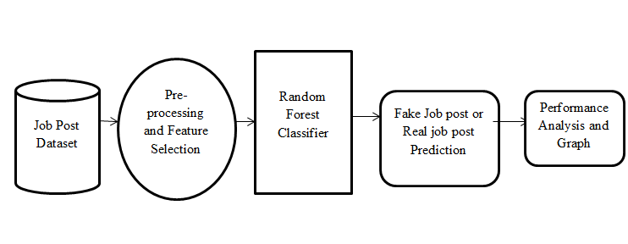
SYSTEM ARCHITECTURE

Slide 13
HARDWARE REQUIREMENTS
System : Pentium i3 Processor.
Hard Disk : 500 GB.
Monitor : 15’’ LED
Input Devices : Keyboard, Mouse
Ram : 4 GB

Slide 14
SOFTWARE REQUIREMENTS
Operating system : Windows 10.
Coding Language : Python
Web Framework : Flask

Slide 15
REFERENCE
Sultana Umme Habiba, Md. Khairul Islam, Farzana Tasnim, “A Comparative Study on Fake Job Post Prediction Using Different Data mining Techniques”, IEEE Conference, 2021.

